Slide 1

Paragraph writing
Prepared By-
Sadia Jaman Nigar,
Lecturer, Sonargaon University

Slide 2
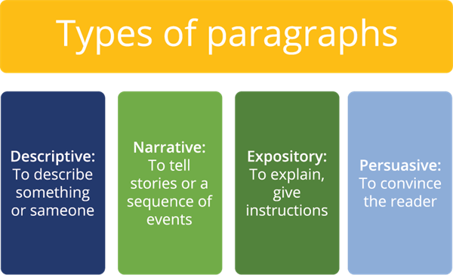
Paragraph and the purpose-
A paragraph is a collection of sentences that focus on a single idea or topic. It acts as a basic element of written communication, offering organization and structure to our writing.
The primary purpose of a paragraph is to present and develop a single idea or topic. Each paragraph should contribute to the overall coherence and unity of the writing."

Slide 3
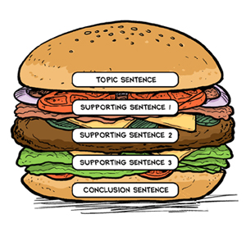
Key Elements of a Paragraph
Topic Sentence: Introduces the main idea of the paragraph.
Supporting Sentences: Provide details, evidence, and examples to support the topic sentence.
Concluding Sentence: Summarizes the main idea or provides a transition to the next paragraph.

Slide 4
The Topic Sentence (Example: "Exercise has numerous benefits for both physical and mental health.)
The first sentence of a paragraph that states the main idea.
A good topic sentence is specific enough to give a clear sense of what to expect from the paragraph, but general enough that it doesn't give everything away.
The author's message about the topic

Slide 5
Supporting Sentences
Types:Descriptions or details, Facts, Examples
Supporting sentences give a reader details to understand a main idea, or evidence to show why a claim is true or correct. You will find supporting sentences in the middle of a paragraph – after the topic sentence, and before a concluding sentence.
Ex- Physically, regular exercise can help control weight, reduce the risk of chronic diseases, and improve muscle strength. Mentally, exercise is known to reduce stress, alleviate anxiety, and boost overall mood."
Providing useful details
Presenting facts or evidence
Providing examples

Slide 6
The Concluding Sentence
The final sentence that wraps up the paragraph or transitions to the next one.
DO - Restate the topic sentence using synonyms. - Restate the topic sentence using a different kind of sentence. - Wrap up your paragraph. - Consider using transition words to signify the end of your paragraph. DON'T - Copy the exact wording of the topic sentence. - Include a new topic. - Focus on a small idea. - Start the sentence with, And now you know.. That is the reason... That's what I learned about... or And that's why...

Slide 7
Tips for Writing a Good Paragraph
Stay on Topic: Focus on one main idea.
Be Clear and Concise: Avoid unnecessary words and details.
Use Transition Words: Help the flow of ideas (e.g., "furthermore," "however").
Vary Sentence Structure: Keep the paragraph interesting.
Proofread: Check for grammar and spelling errors.

Slide 8
Common Mistakes to Avoid
Run-On Sentences: Break them into shorter, clearer sentences.
Lack of Focus: Stick to one main idea per paragraph.
Inconsistent Tense or Point of View: Maintain consistency throughout the paragraph.
Overloading Information: Too much information can overwhelm the reader.

Slide 9

Thank you

